Slide 1
Choosing better open source packages: Lessons from the real world
Michaela (Miki) Demeter
Notes:
I am a Security Researcher for Intel. I have been at Intel for 12 yrs 6 of which have been with a security focus on open source. My career spans 35 years and includes 7 patents for cable and connector design. I worked mainly in the telecom space working on embedded software for major telecom equipment ranging from 56 port T1 to stratum 3 clock drivers all requiring 7 9’s of reliability. I have been working with open source since the early 90’s and continue to do so today.

Slide 2
How well do you know what’s inside your products?

Slide 3
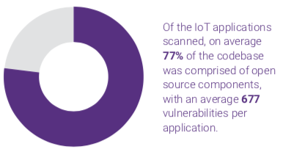
Yikes
2018 Synopsis Open Source Security and Risk Analysis
Notes:
Okay, so that’s a lot of disheartening news. But it gets worse…
78% of the codebases examined contained at least one vulnerability, with an average 64 vulnerabilities per codebase.
Open source usage is continuing to increase.
The average percentage of codebase that was open source was 57% vs. 36% last year. Many applications now contain more open source than proprietary code.

Slide 4
I want to make it easier for you to ship good quality open source software.
Notes:
But I’d like to help make it better. I want everyone to be even more awesome at using open source software, since it helps us achieve faster time to market and lets us “stand on the shoulders of giants” to reach new heights rather than redeveloping existing ideas. I’m pretty passionate about it having been involved in open source for over 25 years.
And hopefully you’re all pretty passionate about shipping good quality software, which means good quality components.

Slide 5
How do I choose good Open Source Packages?
Notes:
Engineers aren’t choosing bad packages because they’re malicious or stupid, they’re choosing them because they’ve got other metrics in mind:
Does it meet our needs now and will it do so in the future?
Does it meet our licensing requirements?
It is small enough for our desired footprint?
Is it what others in the industry are using?
Does it have a good tutorial so we can get someone ramped up to integrate it quickly?

Slide 6
How do I choose Secure Open Source Packages?
Notes:
Security can sometimes fall pretty far down that list, and often developers don’t think of themselves as being capable of making security decisions. But whether you’re trained on making security decisions or not, you are making security decisions when you choose packages to use. And statistically speaking, we’re not making great decisions.

Slide 7
How do I SHIP FASTER WITH Open Source Packages?
Notes:
For a lot of people, what you care about most is making your shipping deadlines, and our security process is another set of hoops you have to jump through. Combining poorly vetted packages with that huge backlog is going to hurt your time to market a lot, and we’re already getting a lot of very upset feedback from people who are in that situation. What we want to do is make sure you’re making good choices early, so you can be more confident of getting a good result when you get package feedback from the reviewers.

Slide 8
Choose a repository
Notes:
This step is to too often overlooked. Many developers today code by google. While this is not necessarily bad. It can cause problems. Choosing a forked repository not the original OSS repo, choosing a closed and archived repository (code.google.com). If you fail at choosing the correct repo all of the rest of your work will be pointless.

Slide 9
Step 1: Take a first look
Notes:
The first step is to quickly peruse the public info about the package to see if it passes a basic sniff test.

Slide 10
Key Questions for a First Look at a New Package
Have you read the readme,?
Does this code appear to be held to good software development standards?
Is this code used professionally or is it a hobby project?
Are there any signs that there are known issues with this code?
Does this code only solve a personal problem for the dev or is it robust enough for other use cases?
Is this code active or is it an archive (abandoned)?
Look for warning signs.
Notes:
So here’s a few key questions for you. <read questions from slide with commentary>
Good software development standards: A co-worker was asked to do a security review on code where everything in cvs was checked in by root, and most of the checkin messages were things like “oops” so we’re mostly talking really blatant stuff here.

Slide 11
Even the developers say to use something else…
“use TweetNaCl.js (a TweetNaCl port to JavaScript) rather than this implementation, which is more likely to perform in constant time and has likely seen more eyes for review/audits.”
************DISCLAIMER************
This code is reference software only and is not feature complete. It should not be used in commercial products at this time. Intel makes no claims for the quality or completeness of this code.
Notes:
Sources: https://github.com/andi506/crypto-js
https://github.com/01org/IntelRackScaleArchitecture
The first one here is a crypto package that quietly says [read end of quote] which basically translates to “this is sometimes really slow and also probably insecure, don’t use it” and the second one is much more explicit “this doesn’t meet our quality standards for commercial products, don’t use it”

Slide 12
What is this?
“I didn’t write this code but I like it.”
Notes:
https://github.com/kbranigan/cJSON
What does this even mean? Is the license of this code legit or are we potentially being exposed to a copyright lawsuit? Is this a dead copy that’s not being updated? Where did this code come from?

Slide 13
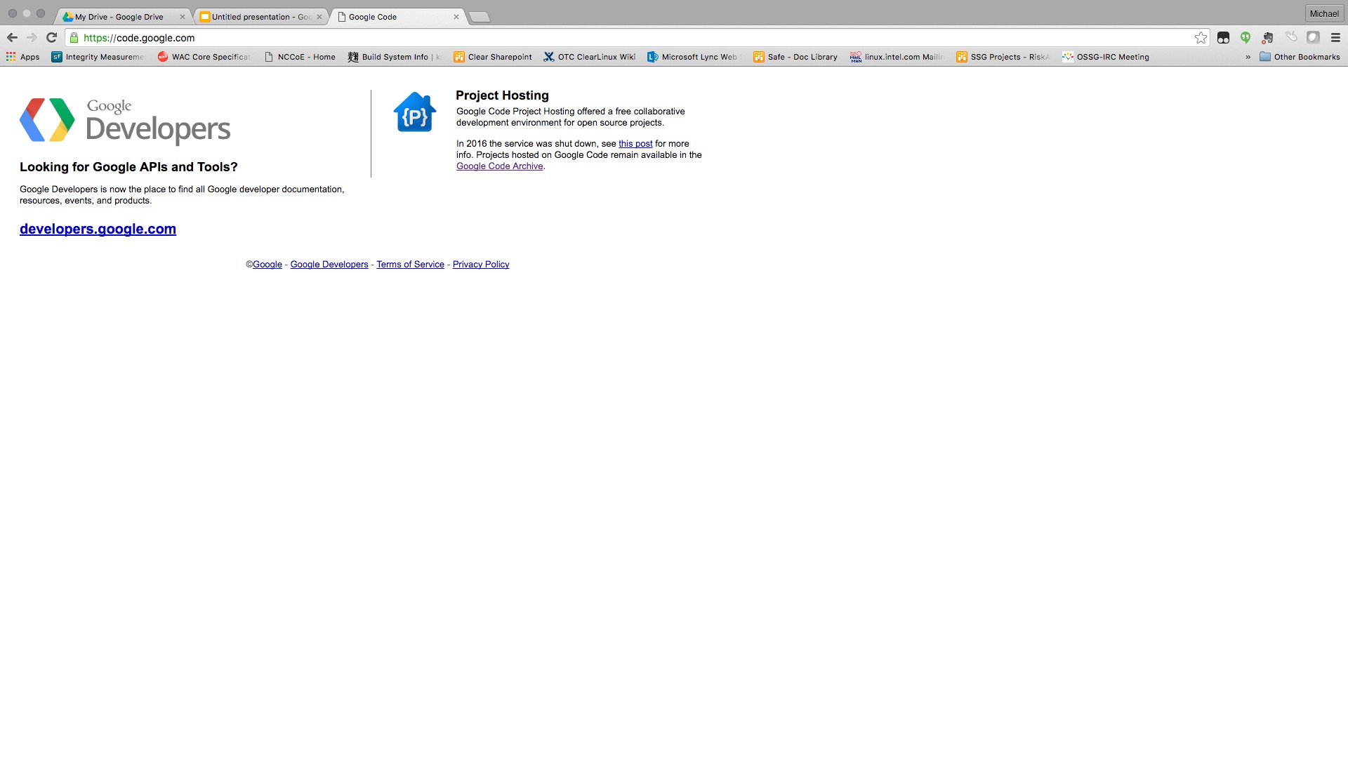
Shut down in January 2016
Notes:
Another warning sign we see is archived code sources, like code.google.com. It shut down in January 2016: if you’re using that url, you’re not getting the latest updated releases.

Slide 14
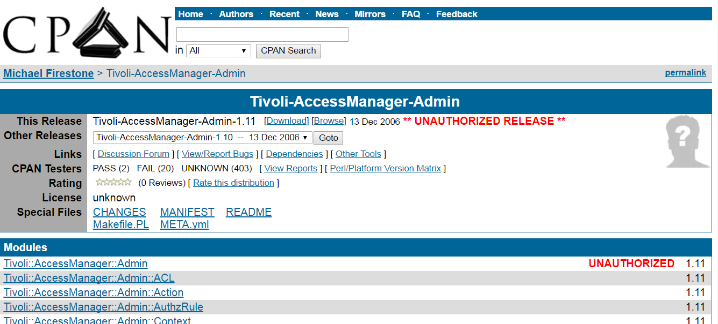
Notes:
This from CPAN:
A co-maintainer uploaded a new release, but because of an oversight wasn’t granted permission on one of the modules. This often happens with distributions that have a different release manager each cycle.
Someone without co-maintainer permissions forked the distribution and uploaded it.
An author makes a new release with a new namespace without realizing that namespace is taken by another author.

Slide 15
“CryptoJS is a project that I enjoy and work on in my spare time, but unfortunately my 9-to-5 hasn't left me with as much free time as it used to. I'd still like to continue improving it in the future, but I can't say when that will be.”
“opencsv was developed in a couple of hours by Glen Smith.”
Notes:
http://opencsv.sourceforge.net/
So here’s two ways developers might tell you that this is a hobby project and not something that’s supported: in the first one, the dev is giving apologies for not having time to work on cryptoJS. In the second, well… is “developed in a few hours” a sign that this code is professional work?

Slide 16
“[This code is] slower and more subjective to side-channel attacks by nature”
Notes:
http://www.literatecode.com/aes256
Sometimes we see requests for code that’s very explicit about the flaws. Sharing code with known problems and attacks is a great way to do research, but is it something that should be part of Intel released software?

Slide 17
Using this will get you banned…
This project was made as a "proof of concept" demonstration of how to detect apps installed on an iOS device, from early 2011. Since then, it has been used extensively in many apps, to the point where Apple made the decision to ban the excessive use of -canOpenURL:, the method which iHasApp relies upon to determine app installation. As a result, using a list of URL schemes for app detection is no longer a viable method.
Notes:
From: https://github.com/danielamitay/iHasApp/
It isn’t just linux. This was a library to help you determine what other apps might be installed on a device. It was so popular and such a violation of privacy that Apple banned the method they used. This had happened a year before the package was requested in the whitelist system.

Slide 18
“cJSON aims to be the dumbest possible parser that you can get your job done with. ”
Notes:
So this one is maybe not so obvious. But let me tell you about some sneaky things that security folk hate seeing:
“elegant” → “we didn’t handle any edge cases”
“lightweight” → “we cut out all the input validation”
“fast” → “we cut out all the error checking”
“we wrote a new parser” → all of the above

Slide 19
Step 2: Check the contributors & activity
Notes:
So, after doing a quick read-through of the front of the website and the readme file, what should you do next? The next thing is to take a look at the contributors and activity of the project.

Slide 20
Key questions about Contributors
How many contributors are active and significant?
Are the key maintainers doing this as part of a job or a hobby?
Is this code actively maintained or is it abandoned?
How many checkins were there in the past year?
Are issues being fixed on a regular basis?
Who is doing the code reviews?
Who takes over if the main maintainer gets sick?
Notes:
So here’s some key questions you might want to ask yourself if you’re not sure what to look for. In short, you want to know how many contributors there are who are recently active, whether things are getting fixed, and how.

Slide 21
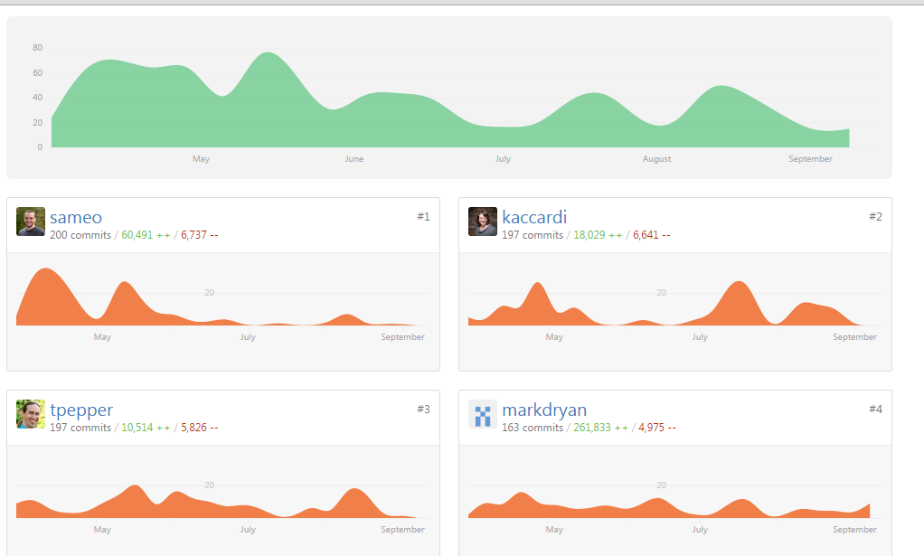
Good example: many active contributors
Notes:
So here’s an example of an active project. I’m cheating a bit with this, since this is an Intel project so we know it meets our standards, but the point is that you want to see several active contributors and at least a few of them recently active if you’re expecting a whitelist rating

Slide 22
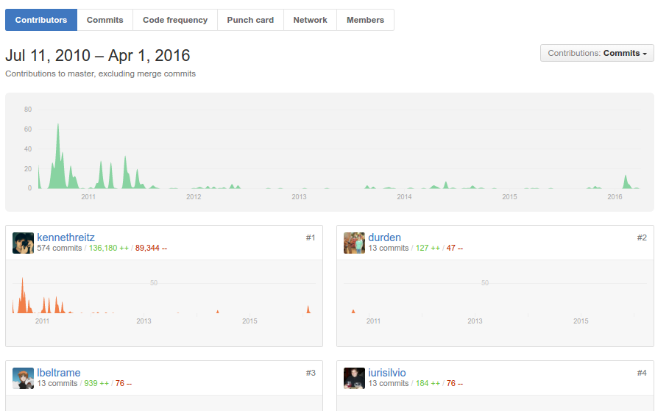
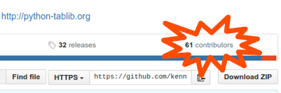
What we see many times: one significant contributor, not recently active
Notes:
Sure, there were 61 contributors, but most of them just fixed a bug or two. Almost all of the code was written by one contributor, and judging by the graph, he’s barely touched it since 2012. This code is probably going to get rated as questionable, because we don’t have evidence that it’s being actively maintained. What happens if this guy gets sick?

Slide 23
Step 3: Check how they handle security issues
Notes:
The next thing to look at is a quick check to see how they handle security issues.

Slide 24
Key Questions about Handling Security Issues
Is there a clear way to report security vulnerabilities?
An ideal procedure should involve a way to keep the vulnerability secret until a fix is found.
Typical good solutions: send email to a special security mailing list. Bug tracker with special “security” flag
If there’s no way to report security issues specifically, assume they have not thought about it (and this is a bad sign)
Is there evidence that vulnerabilities are fixed in a timely manner?
Is there any explanation of what happens when a security issue is reported?
Notes:
So basically, you want to know if they have a procedure for handling vulnerabilities, if they follow that procedure and if it seems to be effective. You may not be able to answer all of these questions, but again, take a few minutes and click around the project’s home page a few times to see if the answers for these are obvious. If they’re not, it may be a neutral sign or a bad sign, but you’re less likely to sail through the whitelisting process with this package.

Slide 25
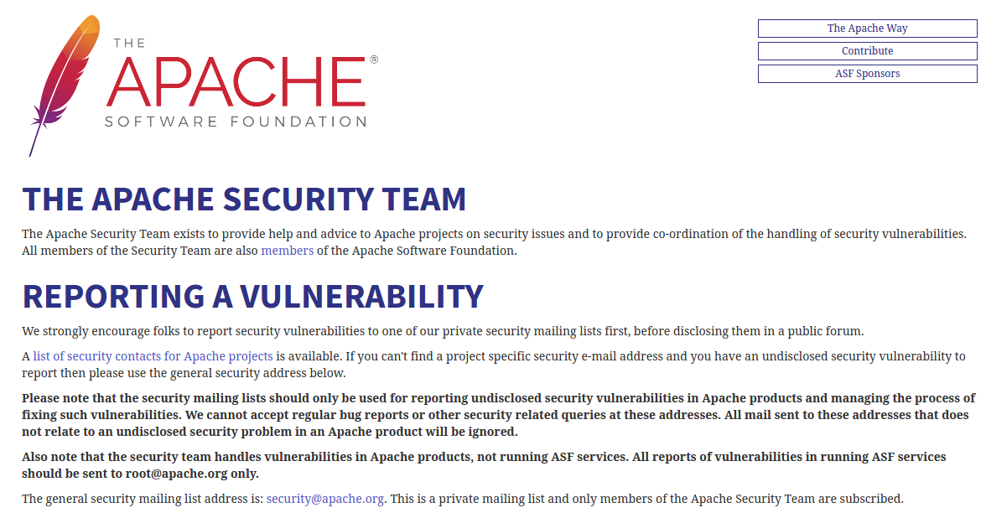
Great Example: http://www.apache.org/security/
Notes:
So one of the best examples is Apache. They have a very clear vulnerability process that we know from experience that they follow, and it applies to all the active projects under the Apache banner.

Slide 26
Negative example: No policy
Notes:
What you’re more likely to find is nothing. No policy, no evidence. This can mean that they haven’t thought about security at all, which isn’t exactly a point in their favor.

Slide 27
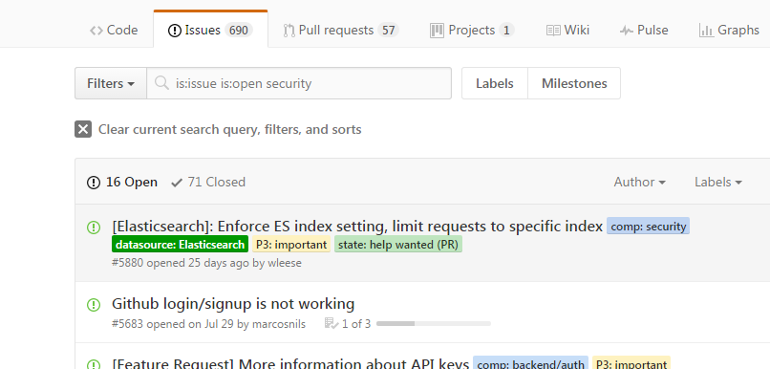
Questionable example: multiple unfixed security bugs
Notes:
And if you can’t find much, you should probably just check their bug tracker and see how much comes up if you search for “security.” Another thing you might see is that they have multiple unfixed security bugs. Again, context matters: sometimes they aren’t real bugs, sometimes the risks are low and the project doesn’t have resources to fix, but if you see this you should go read through all those bugs and see if any of them affect your product.”

Slide 28
Good security reporting does not guarantee action
Notes:
And one last one to note is that good security reporting doesn’t actually guarantee good action. You’re probably not going to know which companies and groups have good reputations, but I want you to be aware that this is an issue that could come up.

Slide 29
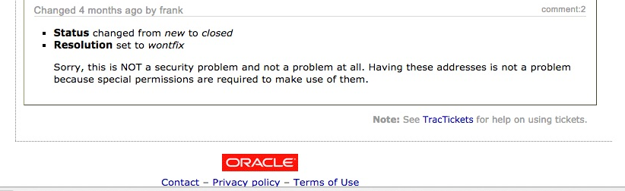
This turned out to be untrue, and a CVE is in the process of being issued
Notes:
Zooming in so you can see it, you can see that the person who triaged this bug said it wasn’t an issue. But thanks to the work of our intern, John Anderson, who provided additional information and a proof of concept, they’ve now acknowledged this as a real issue and issued a public vulnerability number for it and getting it fixed. But without persistence, this security issue would have still been an issue in virtualbox indefinitely!

Slide 30
Step 4: Look at the test suite
Notes:
Another thing you can do if you’re just not sure about a project is to take a look at the test suite.

Slide 31
Key Questions about Test Suites
Testing isn’t the only thing we take into account, but it can be used as a rule of thumb if you don’t know security and want to guess at what might be a good library.
Does this test suite cover bad behaviour?
How comprehensive is this test suite?
Do all tests pass?
Is there continuous integration for tests?
Testing is especially important for libraries that handle user input: parsers, input validation libraries, etc. A poor test suite doesn’t guarantee a blacklisted component, but a good suite often implies a better choice.
Notes:
As before, here’s some key questions for folk who aren’t sure what a “good” test suite looks like. We’re looking for a good variety of tests covering good and bad behaviour, and test suites are really important for things that parse user input.

Slide 32
Test suite qualities
Poor:
Few or no tests
Focus is on known-good cases
No proof of execution / tests aren’t working
Better:
More tests, including many tests for known-bad cases
Tests work and are executed at least sometimes
Best:
Comprehensive test suite including both expected behavior and known bad cases including potential security exploits
Continuous integration or other proof tests are run regularly and pass
Notes:
So what do good and bad test suites look like? I was going to show some examples, but it got unreadable pretty quickly, so let’s just talk qualities. [Speaker will summarize from slide]

Slide 33
No know vulnerabilities does not mean it is secure
CVEs (Common Vulnerabilities and Exposures) aren’t easy to file, sometimes no one from the team knows how
This can be a sign of a lack of security expertise
Sometimes it means no one’s looking
Sometimes it means developers are actively rejecting or hiding issues
Seeing how people react to known vulnerabilities helps us evaluate their security processes.
Notes:
There’s a whole lot of reasons for this. Our security teams actually treat no known vulnerabilities as a negative indicator.

Slide 34
Bringing it all together
Notes:
Okay, so that was a lot of information, let’s sum up what you need to do if you want to reduce risk when choosing open source packages.

Slide 35
Key Takeaways
Better choices make projects more secure and able to ship faster.
Take a first look (Are there warning signs?)
Check the contributors/activity
Check how they handle security issues
Look at the test suite
Be aware of assumptions
Statistically developers will choose poorly
Notes:
So here’s the list all on one slide. If you want to make sure you speed through your security process and have great libraries in your software, start with the whitelist and see if you can choose things that are already rated. If you still need some new things, take a first look at the package and see if there’s anything obviously sketchy about it, see how active its contributors are, see how they handle security issues, and take a peek at the test suite. While you’re doing this, try to be aware of assumptions you may have around security that could lead you down bad paths. And finally, once you’re pretty sure you’ve got a package that’s going to sail through evaluation, get it evaluated by the whitelist team, and hopefully you’ll be ready to ship in no time!

